Slide 1
Analysis of Machine Learning Models for Road Traffic Accidents
IEE 577/ CSE 598: Data Science for System Decision Analytics
Group 7
Riyank Mukhopadhyay (1222313196)
Aesha Shah (1224112825)
Priyal Padheriya (1224053883)

Slide 2
Table of Contents
Introduction
Problem Definition
Dataset
Data Pre-Processing
Data Visualization
Model Selection
Methodology
Evaluation Metrics
Results - Raw Data, Sampling
Fine-tuning
Cross Validation
Feature Importance
Conclusion

Slide 3
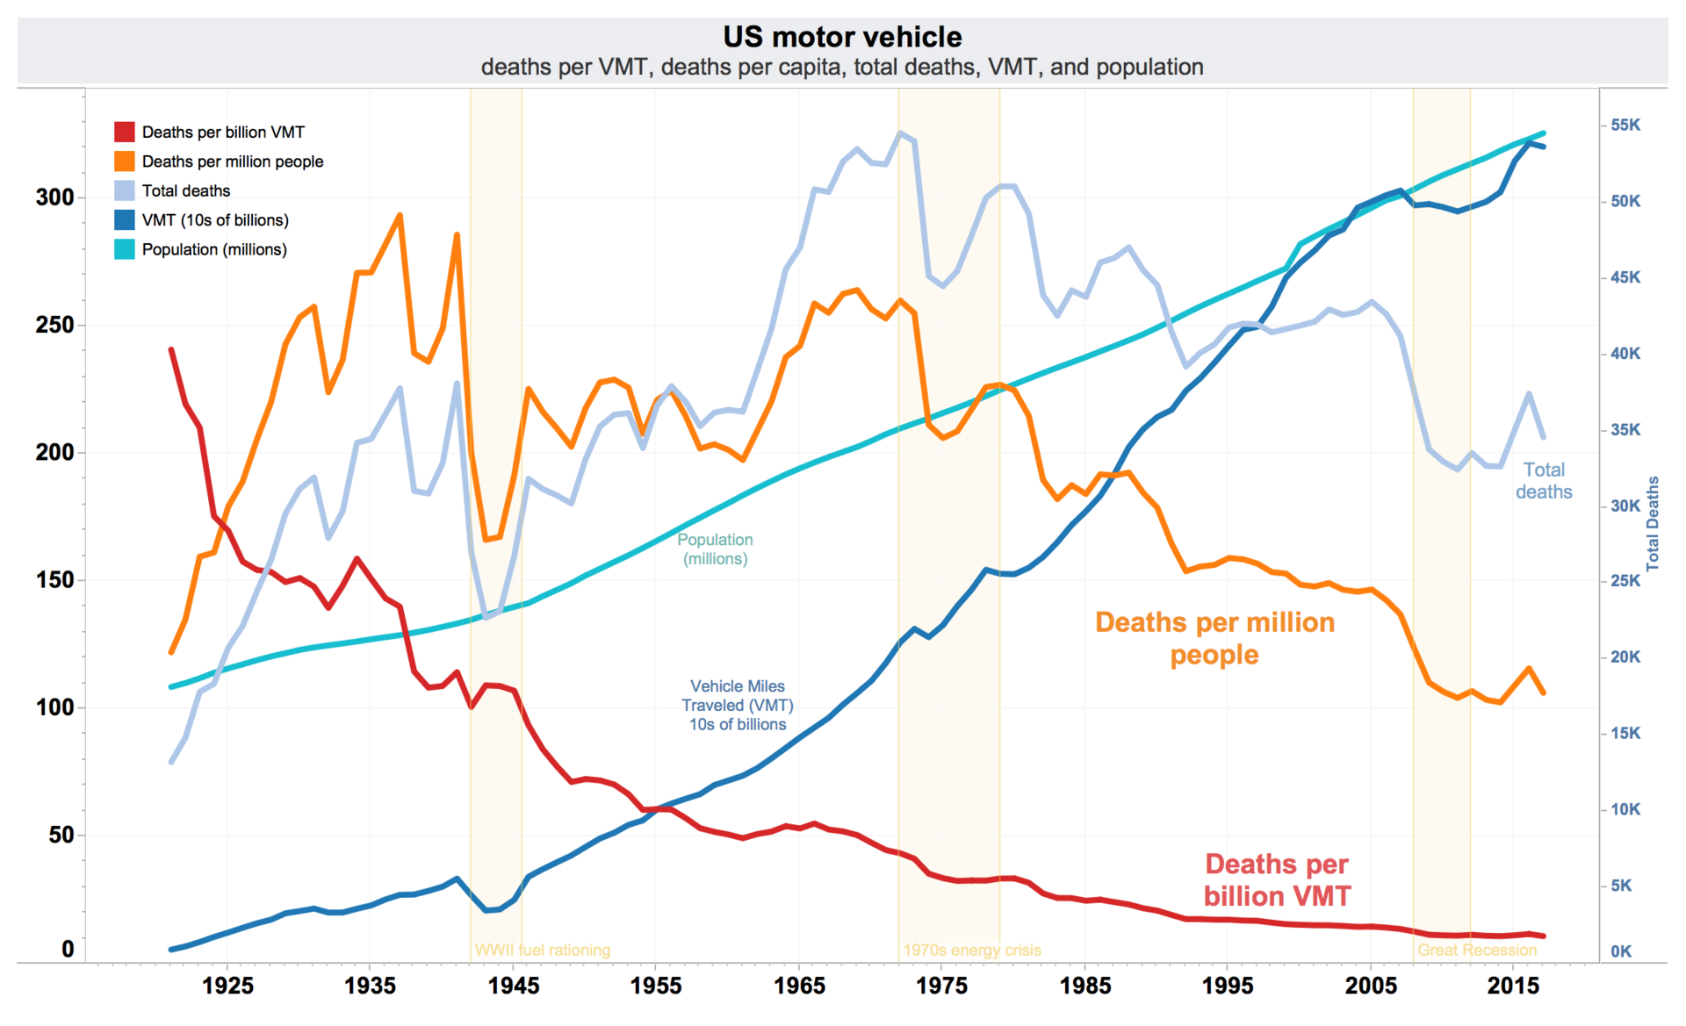
Introduction
Increasing road safety and reducing traffic accidents have been one of the major factors while developing and maintaining roads.
Road accidents have an impact on the economy due to loss of life and property damage and also on the population’s social and emotional well-being.
An effective analysis of the severity of the accidents can help in reducing the traffic accidents.
Also, understanding and analyzing the features that have high impact for Fatal injuries.
Number of Fatalities in the US from 1920 - 2020

Slide 4
Problem Definition
We intend to do an “Analysis of different machine learning models for Road Traffic Accidents”.
The problem can be classified into a Supervised Learning Task where the Road Traffic Accidents (RTA) dataset will be used for benchmarking the evaluation metrics of various multi-label classification machine learning models.

Slide 5
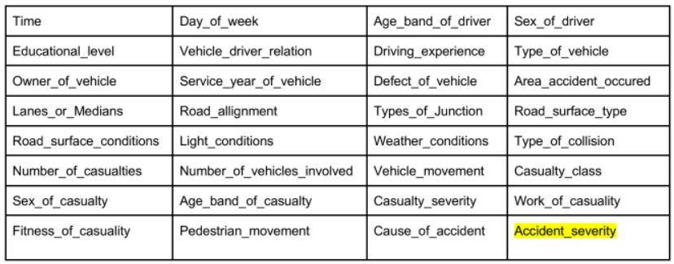
Dataset
The data set has been prepared from manual records of road traffic accidents of the year 2017-20.
All the sensitive information has been excluded during data encoding and finally, it has 32 features and 12316 instances of the accident.
The target attribute is ‘Accident_severity’, which contains 3 categorical possible values, the values indicate an accident injury severity:
Slight Injury
Serious Injury
Fatal Injury

Slide 6
Data Pre-Processing
Selecting useful columns to keep and removing the rest
Predictive - useful
Irrelevant / Bad - drop
Handling Null/Missing values
Most frequently used - mode
Converting categorical values
Using map()
Using Label Encoder
Mapping remaining categorical columns to numeric
Train/Test Split
Train - 70%
Test - 30%

Slide 7
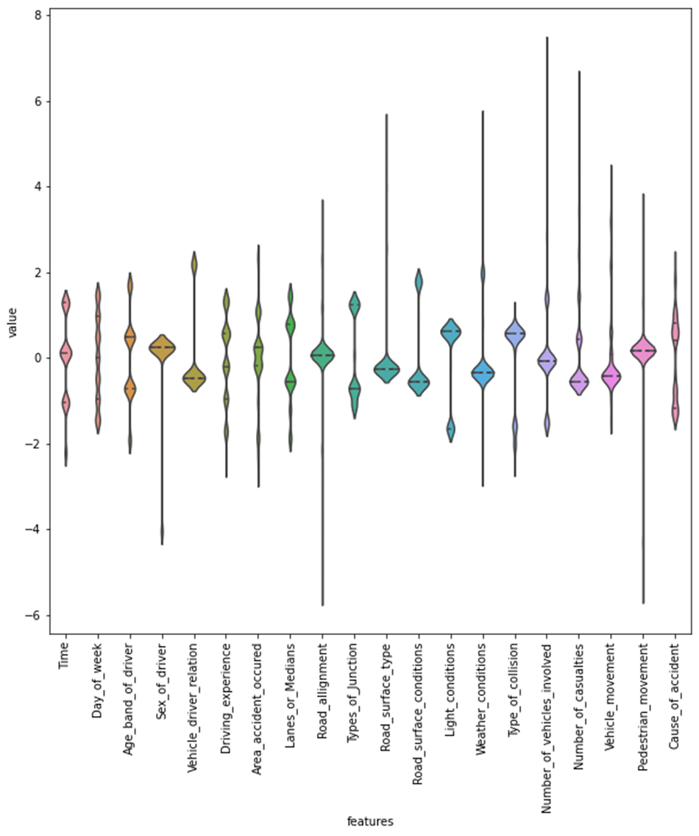
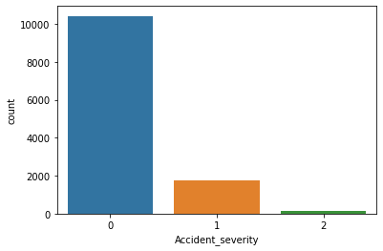
Data Visualization
0: Slight Injury
1: Serious Injury
2: Fatal Injury
Target Class
Seaborn.violinplot for the 20 features

Slide 8
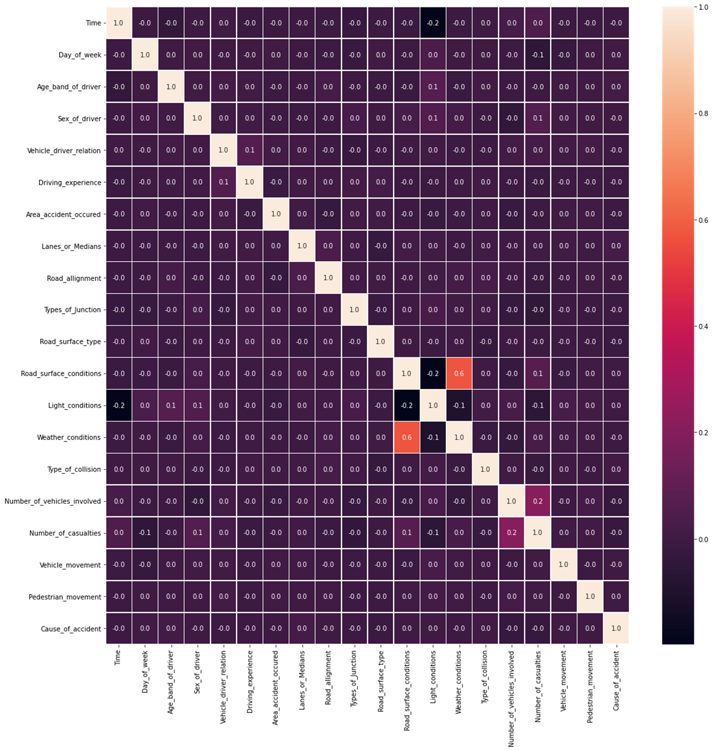
Data Visualization (contd)
Correlation Map of the 20 features considered

Slide 9
Model Selection
Labelled Data
Output Column - Accident Severity
Categories:
Slight Injury
Severe Injury
Fatal Injury
Supervised Learning - Classification Models
Models we used:
Decision Tree Classifier
Random Forest Classifier
k-Nearest Neighbor Classifier
Support Vector Machine Classifier

Slide 10
Methodology
The following Supervised Machine Learning Models were used:
Decision Trees - A decision tree contains two different entities - decision nodes and leaves. Decision tree works on top-down approach, i.e. the algorithm starts from the root node and on the basis of the comparison with the dataset, it moves forward to the next node.
Random Forest - consists of a finite number of decision trees in various subsets of the dataset from which it takes the prediction and based on a majority vote of predictions it predicts the final outcome. The number of trees present in a random forest is directly proportional to the accuracy of the model and can prevent the issue of overfitting.
Support Vector Classifier - has support for both sparse and dense sample vector inputs. The aim of the SVC algorithm is to find a hyperplane in N-dimensional space that clearly classifies the data points. It can be used to find the optimal boundary between the outputs.
K-Nearest Neighbors - predict a target variable using one or more independent variables. In this algorithm, a number ‘k’ which is the nearest neighbor to the data point that is to be classified is selected.

Slide 11
Evaluation Metrics
Accuracy - Ratio of correctly predicted observation to the total observations. Accuracy is a great measure but only when you have symmetric datasets where values of false positive and false negatives are almost same.
Accuracy = TP+TN/TP+FP+FN+TN
Precision - Ratio of correctly predicted positive observations to the total predicted positive observations.
Precision = TP/TP+FP
Recall - Ratio of correctly predicted positive observations to the all observations in actual class.
Recall = TP/TP+FN
F1-score - F1 Score is the weighted average of Precision and Recall, taking into account both false positives and false negatives into account. F1 is usually more useful than accuracy, especially if you have an uneven class distribution.
F1 Score = 2*(Recall * Precision) / (Recall + Precision)

Slide 12
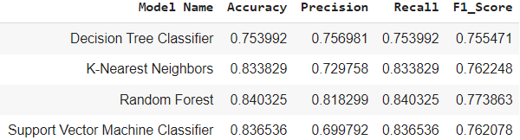
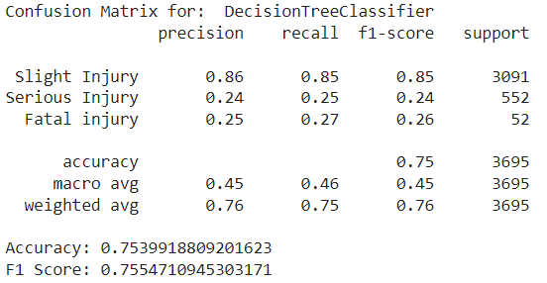
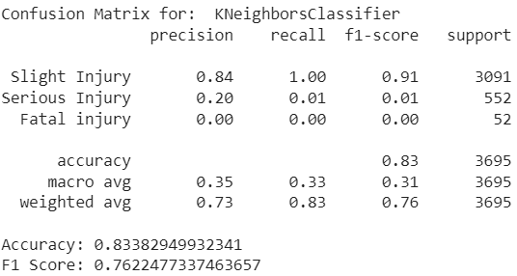
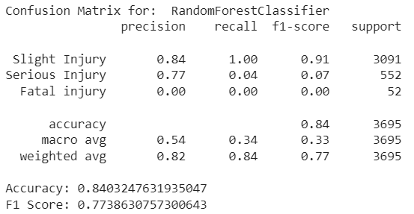
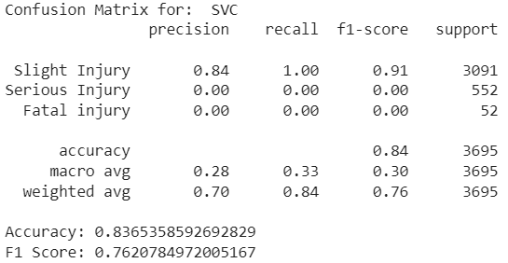
Results - Raw Data

Slide 13
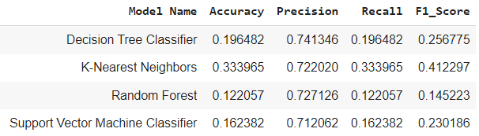
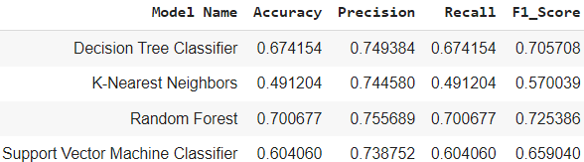
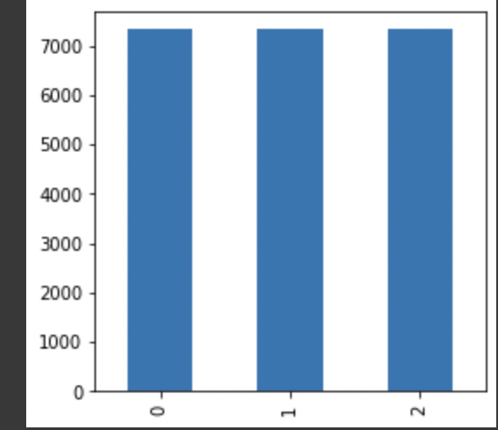
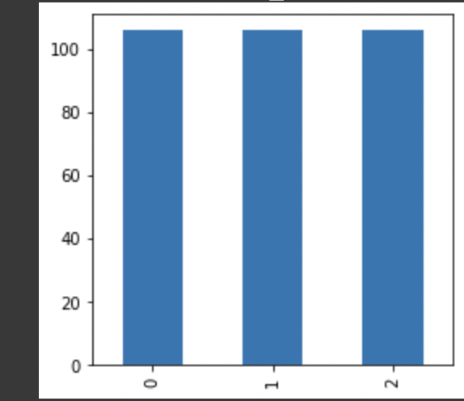
Results - Sampling
Under Sampling (US)
(b) Over Sampling (US)
NearMiss()
SMOTE()

Slide 14
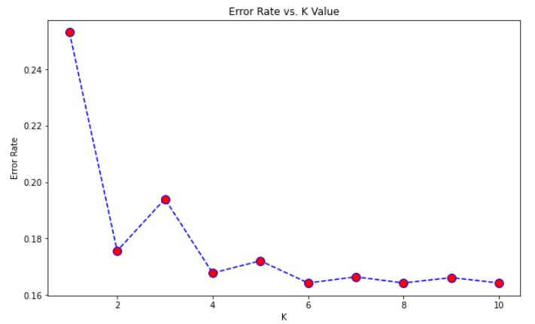
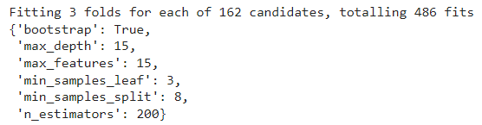
Fine-tuning: HyperParameter Tuning
KNN
(b) Random Forest
The above set of hyperparameters were obtained after performing GridSearchCV
Here, K = 5 gives the minimum error = 0.1642.

Slide 15
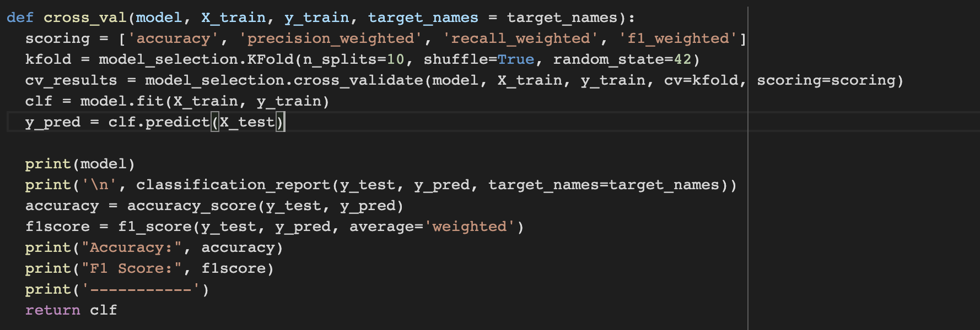
Cross Validation
Cross Validation on best-performing models - KNN and Random Forest
KNeighborsClassifier(n_neighbors=5)
RandomForestClassifier(bootstrap = True, max_depth = 15 ,max_features = 15, min_samples_leaf = 3, min_samples_split = 8, n_estimators=200)]

Slide 16
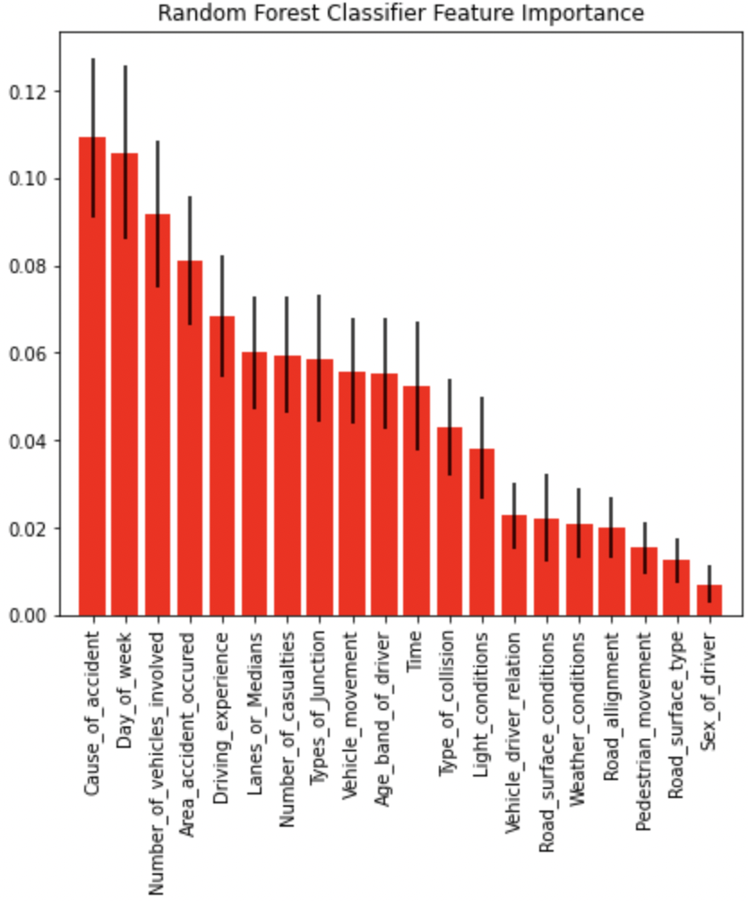
Feature Importance
We perform Feature Importance on best-performing model - Random Forest

Slide 17
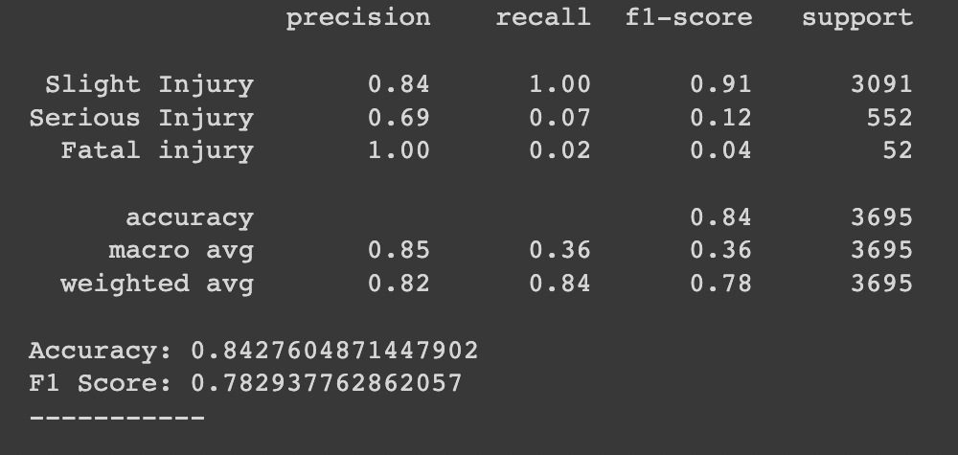
Conclusion
Confusion Matrix for Best-performing model -
Decision Tree Classifier after Hyperparameter Tuning and Cross Validation

Slide 18

Any questions?

